Slide 1
Quantum Fourier Transformation
By Savas Sotrillis

Slide 2
What is a QFT
It’s a linear transformation of quantum bits-qubits
What is a quantum bit?
What is a bit?
What is the difference?

Slide 3
Bit
A bit is the smallest unit of information we can use on our computers
A binary unit is the type of bit we’re used to using on our classical computer.
This bit can be represented in two different states
State ‘1’ or state ‘0’
However, it can not be represented in both

Slide 4
Qubit
It’s the exact same thing as a binary unit but in more dense coding
It can be represented in different states of ‘0’, ‘1’ or both(a c-linear combination of zero and one).
A binary bit can be changed to a qubit but a qubit can not become a binary bit, due to the qubit being “larger”.

Slide 5
Where does QFT come from?
It comes from another transformation called, Discrete Fourier Transformation, which comes from the Fourier Transformation.
The FT helps find the period of a function.
The DFT is derived from the FT and is a discrete way of using the FT.
QFT is a derivation of the DFT, we use the DFT on the amplitudes of the quantum states

Slide 6
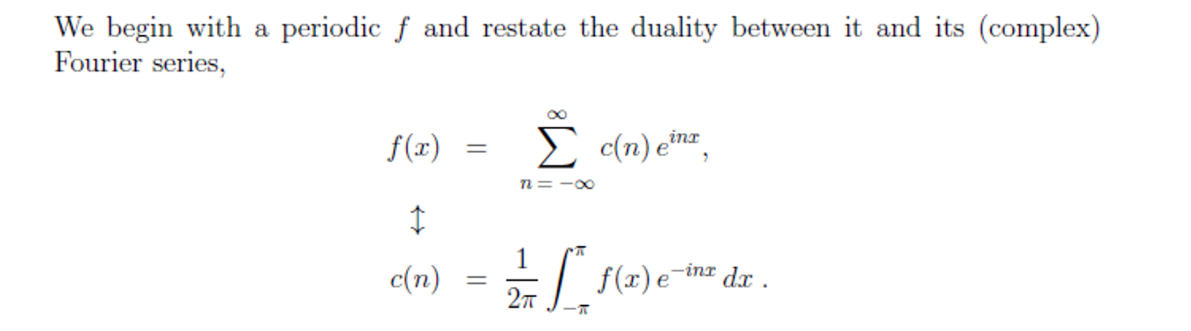
FT

Slide 7
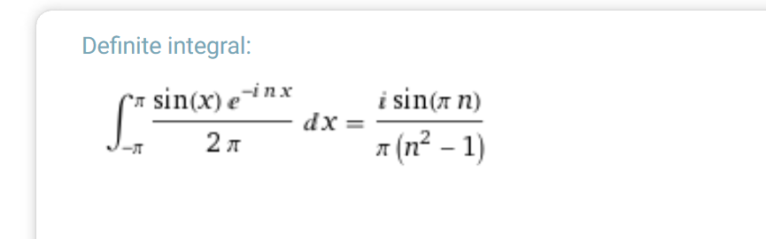
Sin(X)

Slide 8
DFT
We start with FT and making the following adjustments
The integrals will become sums from 0 to N-1. Rather than evaluating f at real continuous x, we will be taking the N discrete values of the vector (fk) and producing a complex spectrum vector (Fj) that also has N components.
The factor of Squareroot(1/2π), will be replaced by a normalizing factor of 1/Sqaureroot(N)
We will use Nth roots of unity, ω^{jk}, in place of the general exponential, e^{isk}

Slide 9
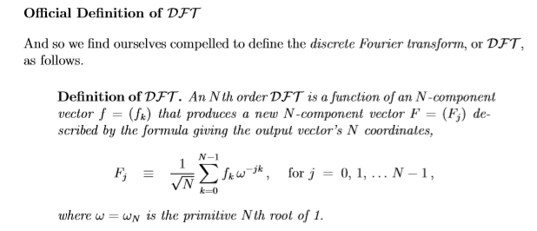

Slide 10
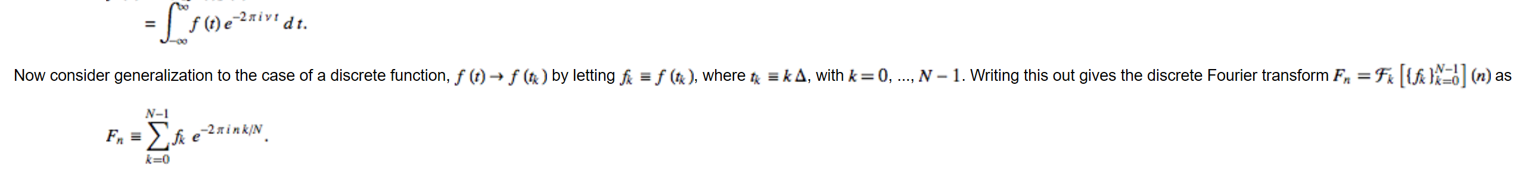
Small Visualization of how it changes

Slide 11
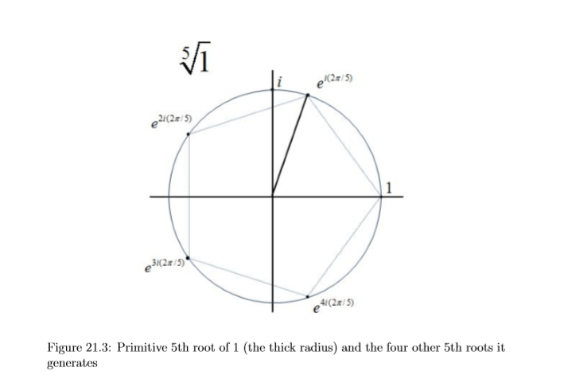
e^(2πik/n) 1≤k≤n,gcd(k,n)=1.

Slide 12
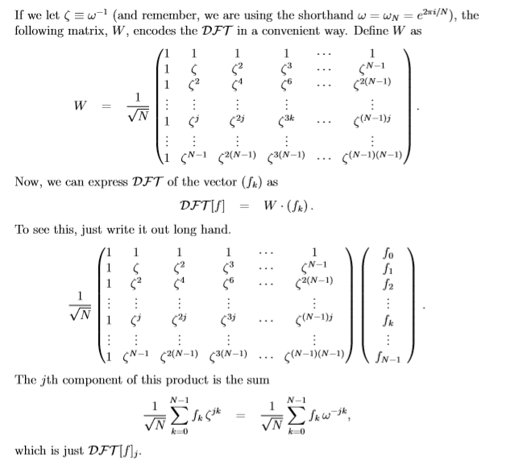

Slide 13
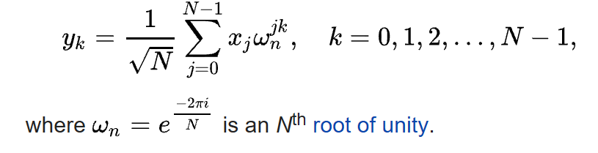
QFT

Slide 14
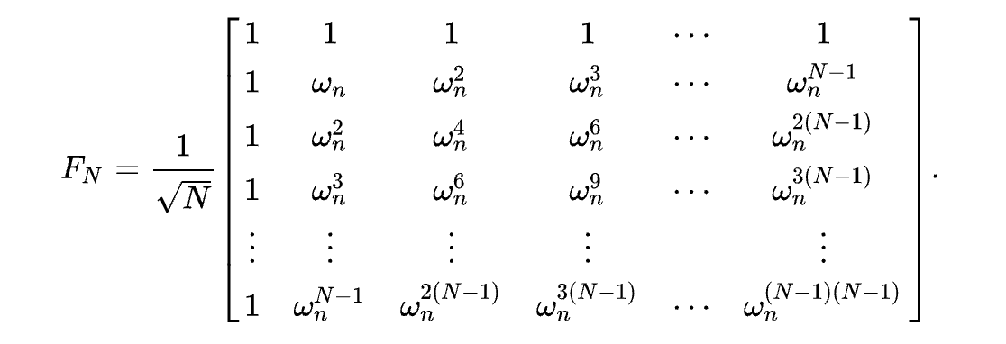

Slide 15
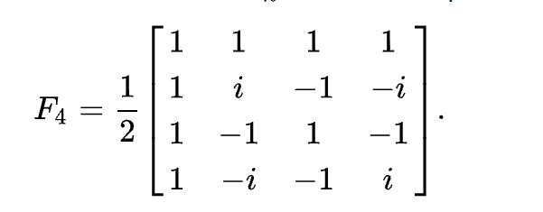
Example found on Wikipedia

Slide 16
Why do we care?
What is RSA?
How does it work?
Why are we relating RSA to this discussions?

Slide 17
Proof that RSA is just a period
P=5
Q=13
N=48
E=5
A=5 encoded
D= 29 decryption key
5^0mod48=1
5^1mod48=5
5^2mod48=25
5^3mod48=29
5^4mod48=1
5^5mod48=5
5^6mod48=25
5^7mod48=29

